Slide 1
Which edges matter?
Aayush Bansal (CMU), Adarsh Kowdle (Microsoft), Devi Parikh (VT), Andrew Gallagher (Cornell), Larry Zitnick (MSR)

Slide 2
Edge types

Slide 3
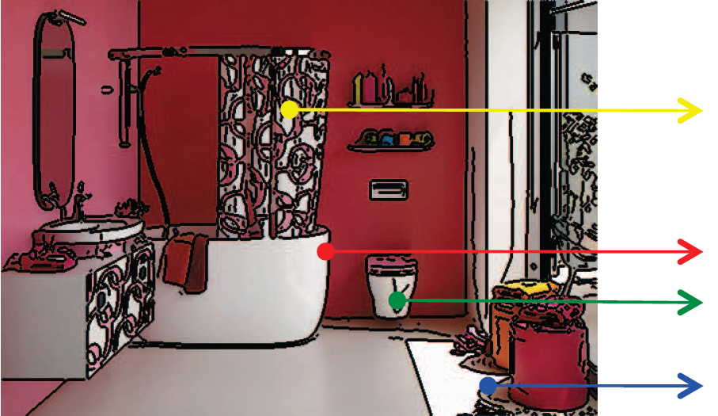
Edge types
Albedo
Depth
Surface normal
Shadow

Slide 4
Which are useful for recognition?

Slide 5
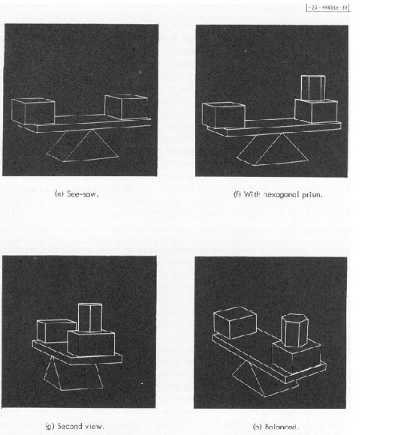
Roberts, 1965

Slide 6
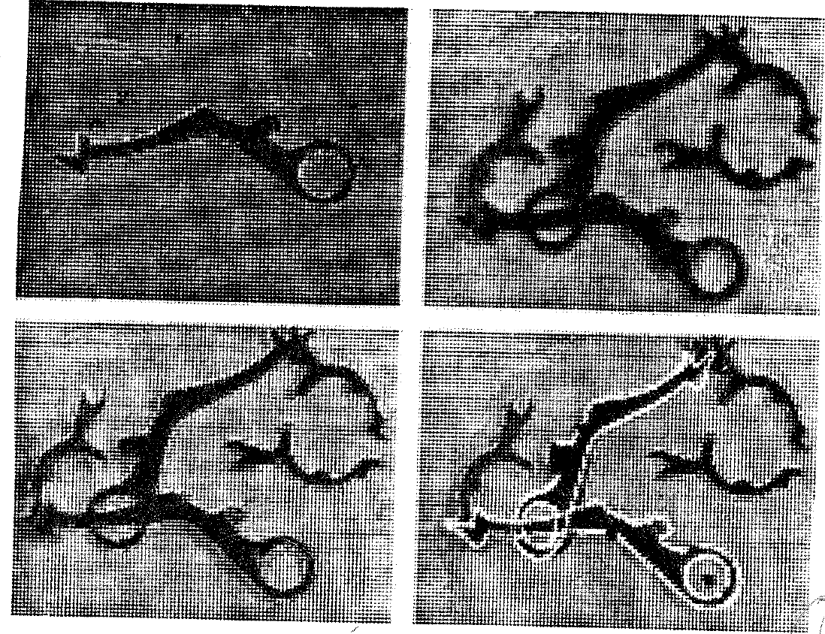
Huttenlocher and Ullman, 1987

Slide 7
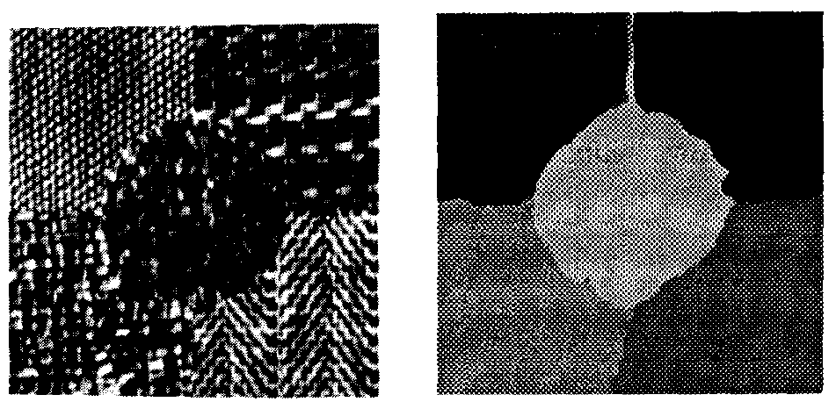
Jain and Farrokhnia, 1990

Slide 8
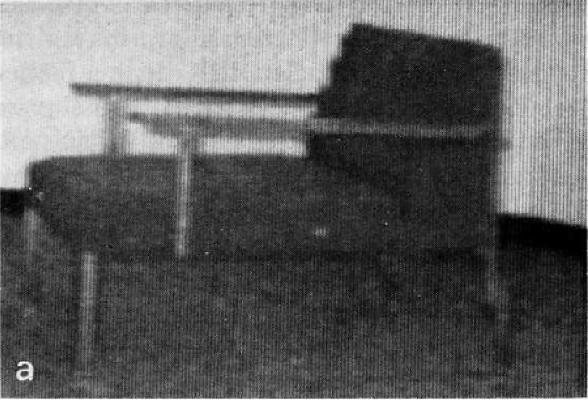
Kanade, 1981

Slide 10
Eitz etal., 2011

Slide 11
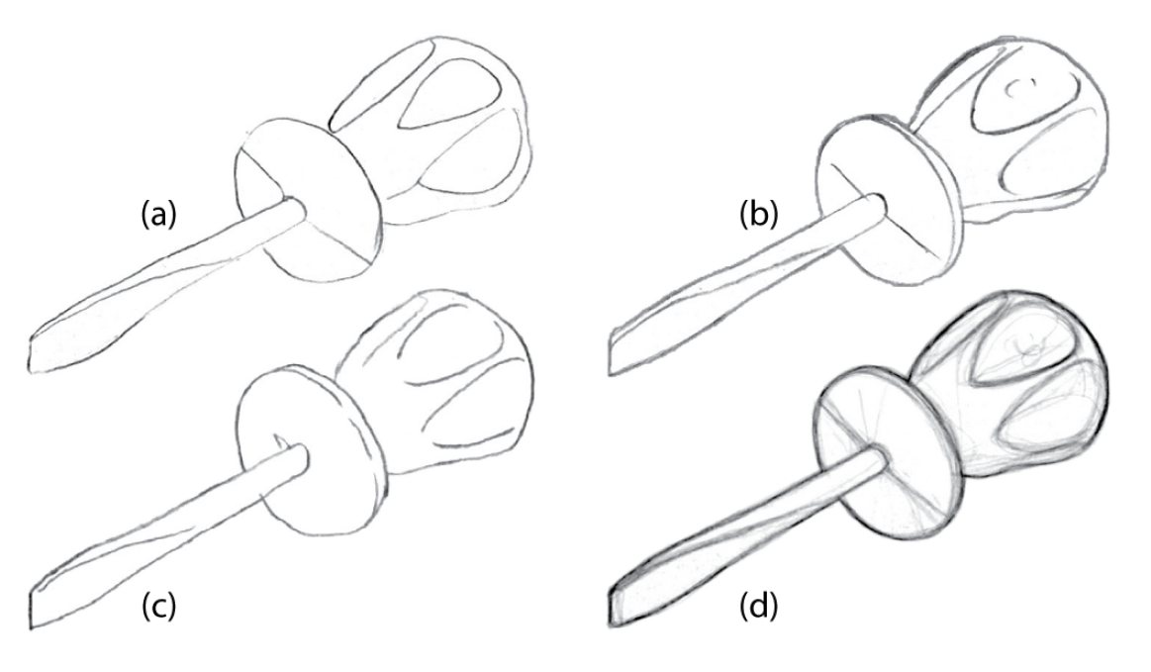
Cole etal., 2008

Slide 12
Can we isolate the effect of different edge types?

Slide 13
Synthetic scenes
46 scenes, Google 3DWarehouse

Slide 14
Synthetic scenes
Black and white

Slide 15
Synthetic scenes
Albedo

Slide 16
Synthetic scenes
Gray surface

Slide 17
Synthetic scenes
Gray shaded

Slide 18
Synthetic scenes
Depth

Slide 19
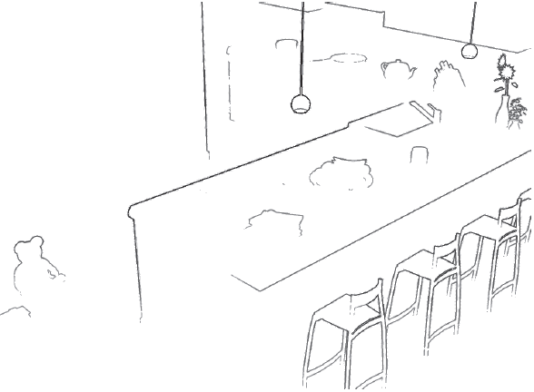
Edges
RGB
Albedo
Gray surface
Gray shaded
Depth

Slide 20
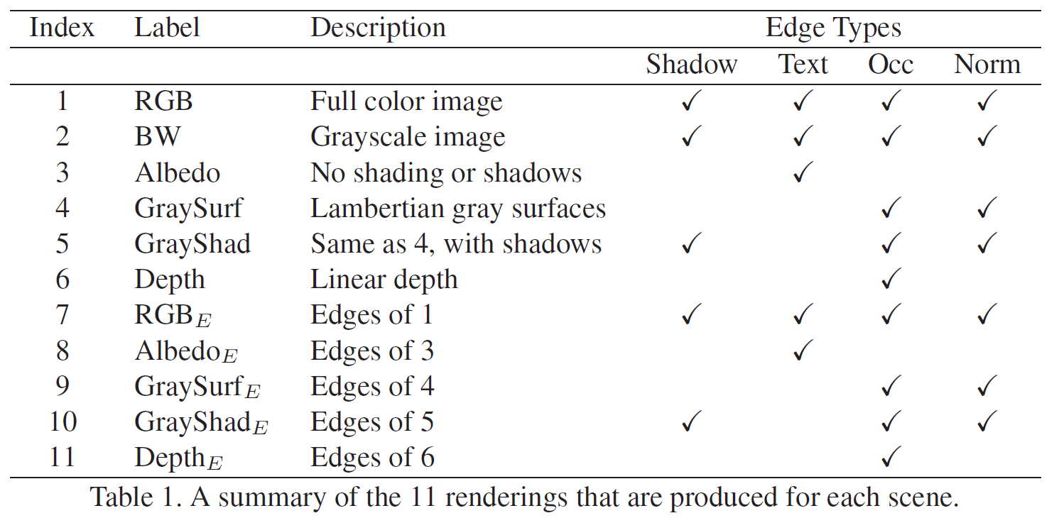

Slide 21
Human studies
265 objects, 11 scene types, 10 subjects per test

Slide 22
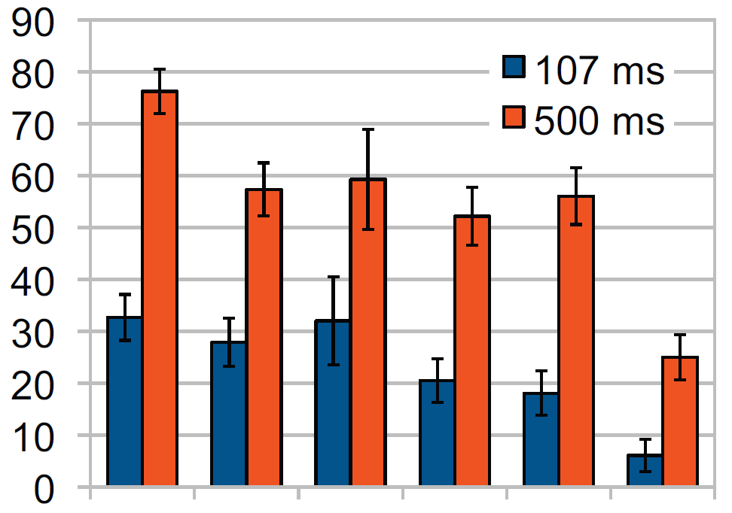
Results

Slide 23
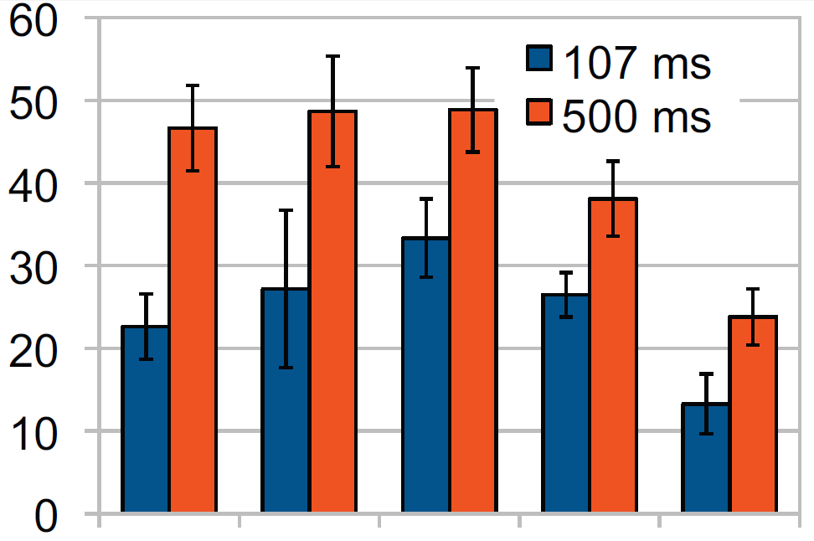
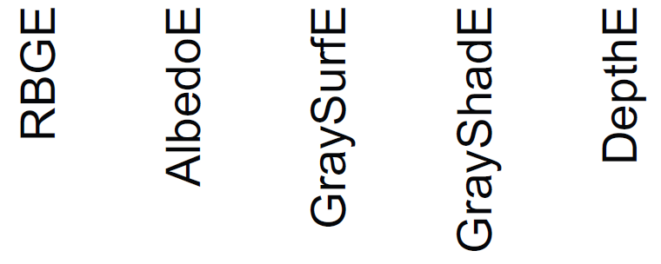
Results

Slide 24
What type of edges do our edge detectors find?

Slide 26
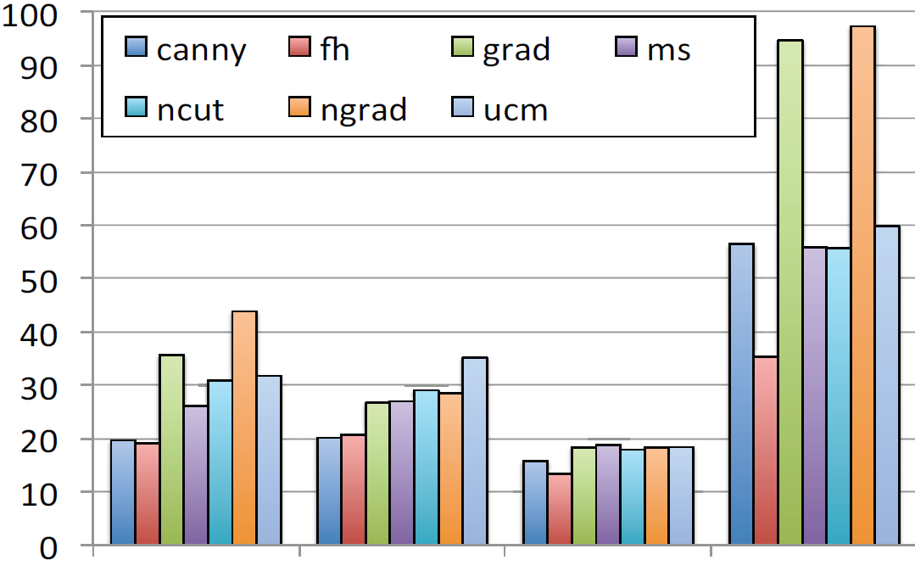
Precision
Depth
Surface normal
Shadow
Texture

Slide 27
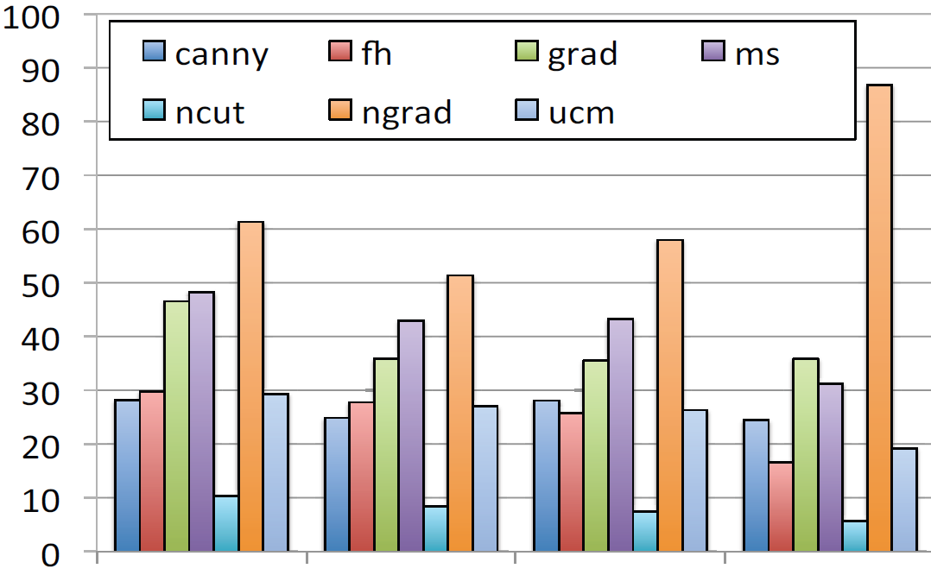
Recall
Depth
Surface normal
Shadow
Texture

Slide 28
Can we further improve our edge detectors?

Slide 29
Contour detection
Parikh and Zitnick, CVPR 2012

Slide 30
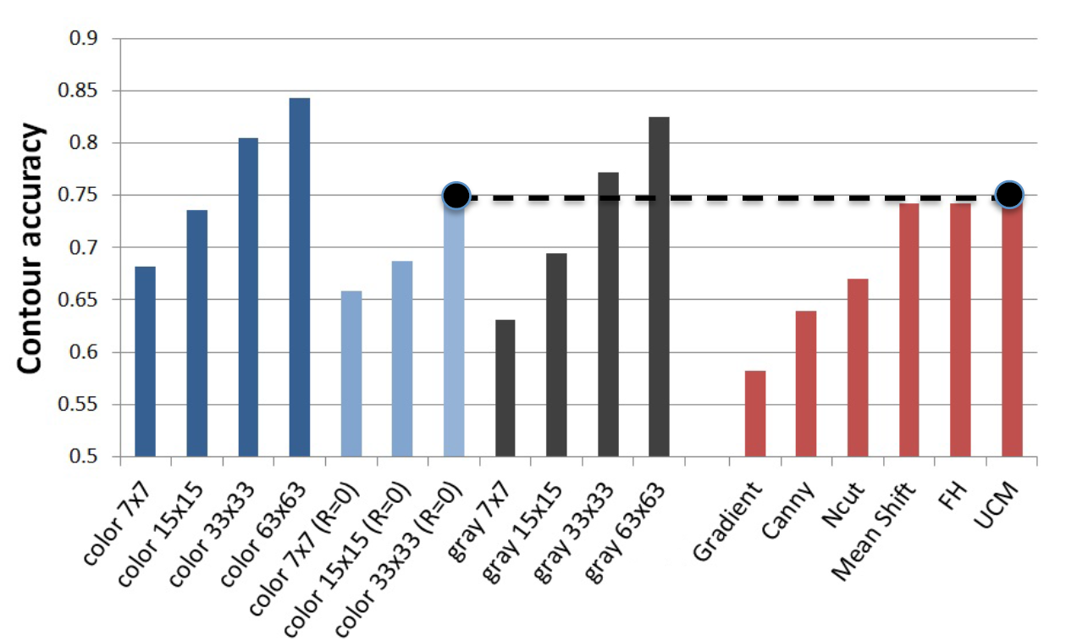

Slide 31
Conclusion
Depth and surface normal edges are most informative for recognition
Most automatic edge detectors find a significant number of albedo and shadow edges
Better methods for evaluating edge detectors?
Are lines important or just edges?

